Slide 1
Fun Facts
The name “NoSQL” was in fact first used by Carlo Strozzi in 1998 as the name of file-based database he was developing. It was a relational database.
Neal Ford coined the term Polyglot Programming in 2006
SABRE, a database still used in the airline industry, predates relational databases (however, they began using a relational database is 2001)
Ingres and System R were two early relational database prototypes in the 70s
The term "relational database" was invented by E. F. Codd at IBM in 1970
Some claim that “NoSQL” now means “Not Only SQL”, and that it isn’t anti-relational
Rackspace used the term “NoSQL” for a conference in 2009.
Terms: “Relational Winter” gives way to “Database Thaw” (ok, not a fact, but still fun)

Slide 2

Which Azure Database Option Should I Choose?
Anne Bougie Senior Software Developer Concurrency, Inc.
Twitter: @bougiefever
Understanding Database Options

Slide 3
Which Azure Storage Option Should I Choose?
Anne Bougie
Senior Software Developer, Concurrency Inc.
@bougiefever
http://www.bougiefever.com
https://github.com/bougiefever

Slide 4
Ways to Store Data in Azure (Non-Inclusive)
SQL
Azure SQL
DocumentDb (Cosmos)
Azure Table Service (Cosmos)
Azure Redis Cache
Hbase
Gremlin (Cosmos)
NoSQL

Slide 5
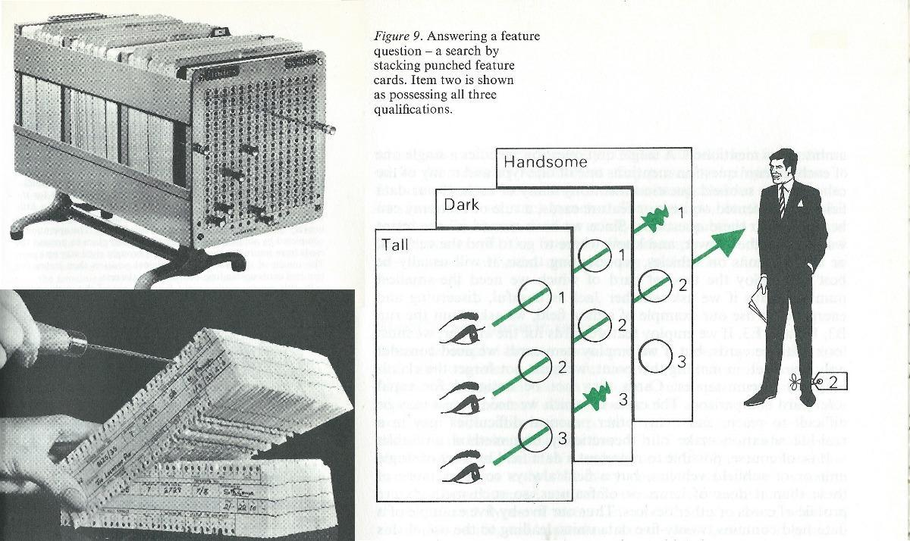

Slide 6
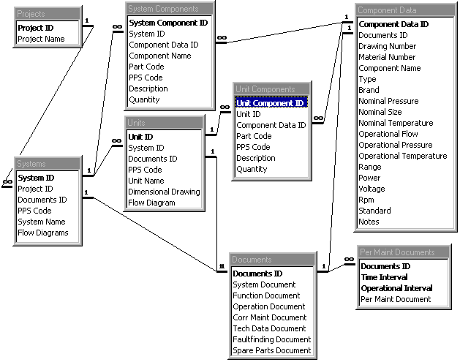

Slide 7

SQL
NoSQL
Relational
Schema-less
Persistent
Clusters
Schema
Scalability
Transactional
Sharding
Concurrency
Partitions
Data Integrity
Fast Data Access

Slide 8
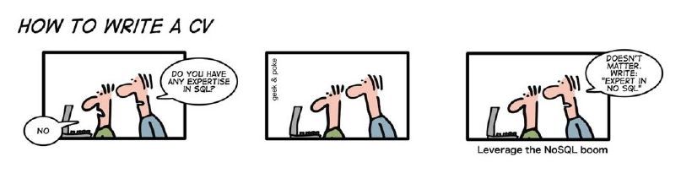
Sql vs NoSql vs Excel Spreadsheets

Slide 9




SQL
NoSQL
Querying Data
Transactions
Scalability
Configuration/Management
Schema
Speed

Slide 10

SQL
NoSQL

Slide 11
SQL
NoSQL

Slide 12

Impedance Mismatch
Order
Order
Order Id: 1234
Player: Mojo Jojo
The object-relational impedance mismatch is a set of conceptual and technical difficulties that are often encountered when a relational database management system (RDBMS) is being served by an application program (or multiple application programs) written in an object-oriented programming language or style, particularly because objects or class definitions must be mapped to database tables defined by relational schema.
Player Assets
In-App Purchase
1 | Gems | 250 | $5
2 | Potions | 10 | $10
Line Items
Financial
Credit Card: 4012888888881881
Expiration: 5/2020
Credit Card

Slide 13
Impedance Mismatch
Order
Order
Order Id: 1234
Player: Mojo Jojo
Player Assets
In-App Purchase
1 | Gems | 250 | $5
2 | Potions | 10 | $10
Line Items
Financial
Credit Card: 4012888888881881
Expiration: 5/2020
Credit Card

Slide 14
NoSQL (Document)
{
orderId: 1234,
player: ‘Mojo Jojo’,
inAppPurchase {
date: 1/1/2017,
items: [
{
objectType: ‘Gem’,
quantity: 250,
priceEach: 0.02
},
{
objectType: ‘Potion’,
quantity: 10,
priceEach: 1.00
}
]
}
…
Order
Order Id: 1234
Player: Mojo Jojo
In-App Purchase
1 | Gems | 250 | $5
2 | Potions | 10 | $10
Financial
Credit Card: 4012888888881881
Expiration: 5/2020

Slide 15
NoSQL
Key-Value
Document
DocumentDb
Azure Table Service
Azure Redis Cache
Graph
Gremlin
Column Family
Azure Hbase

Slide 16

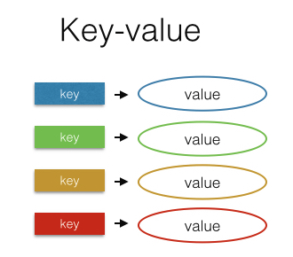

Key Value

Slide 17
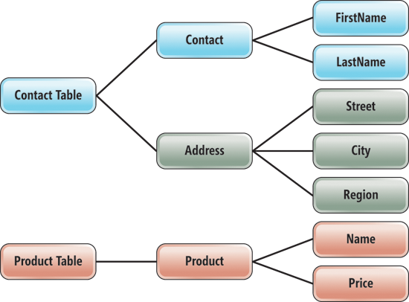
Azure Table Service
Fast reads & writes
Flat data structure
Schema-less
Partition key
Row key
Time stamp
Service will scale out using partition key

Slide 18
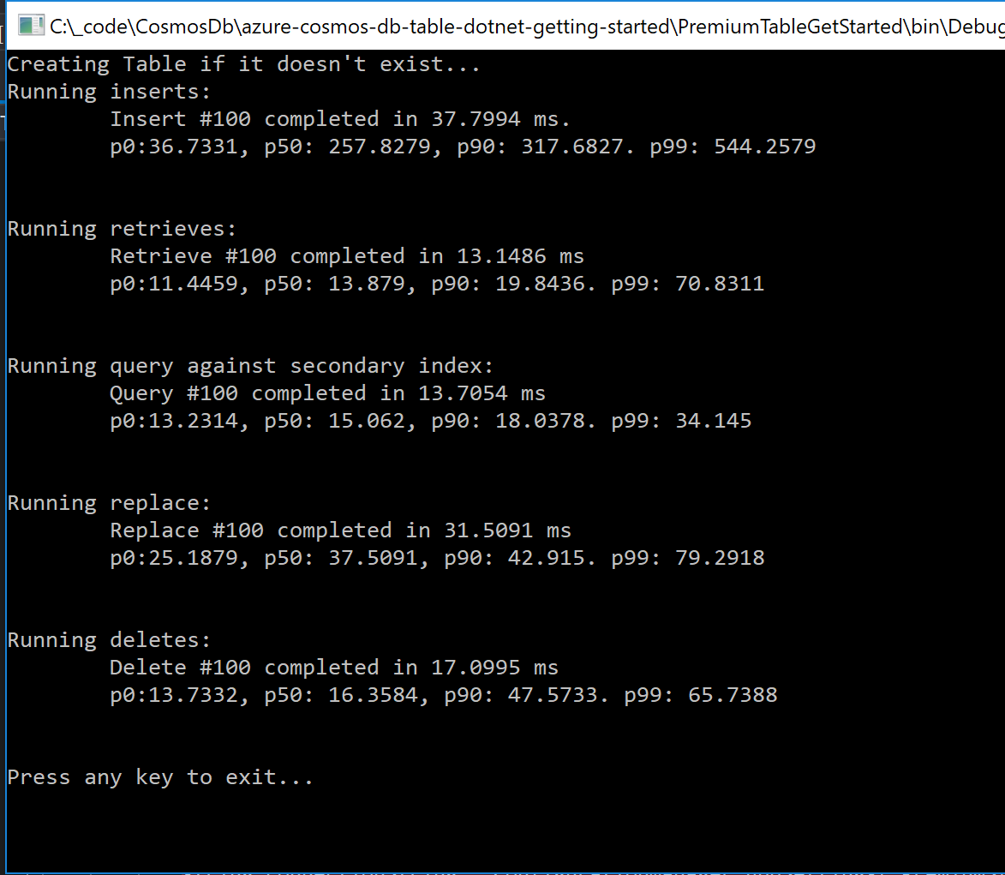
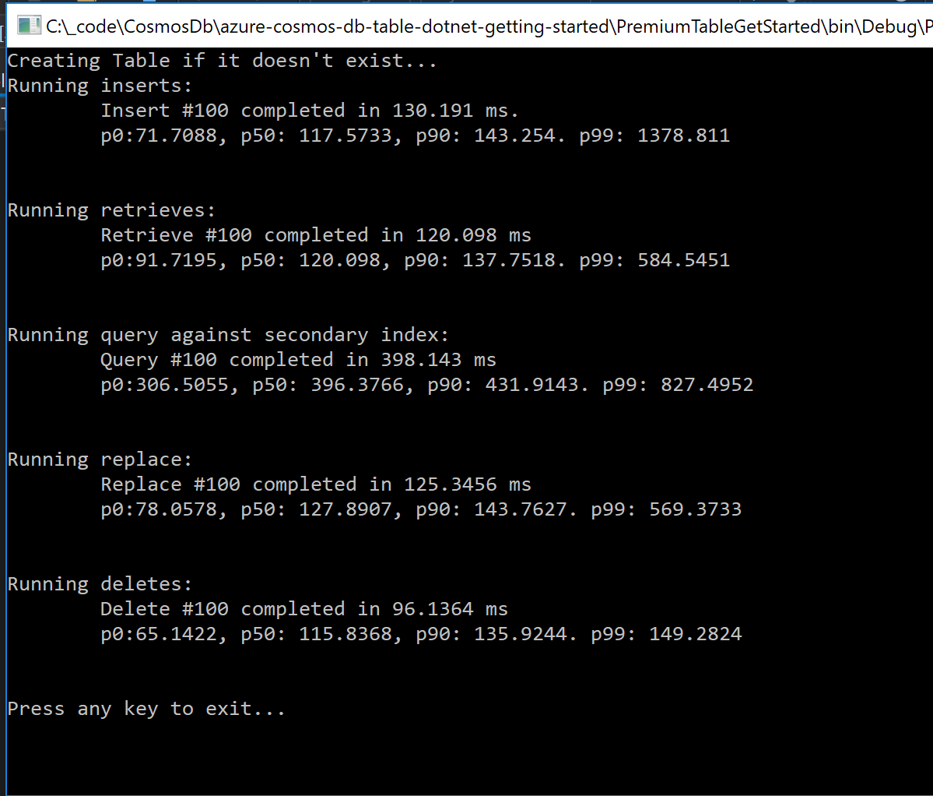

Slide 19


Azure Redis Cache
In memory key-value store
Very fast reads (faster than table storage),
Used as a database, cache and message broker
Transactions
Expiration of items

Slide 20
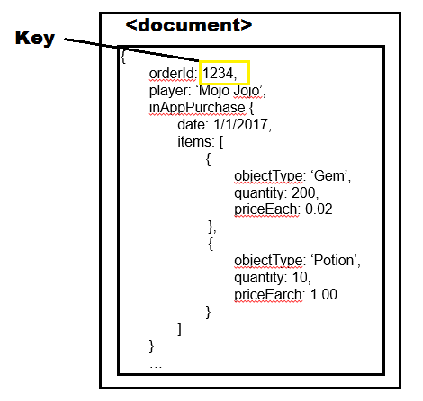
Document

Slide 21
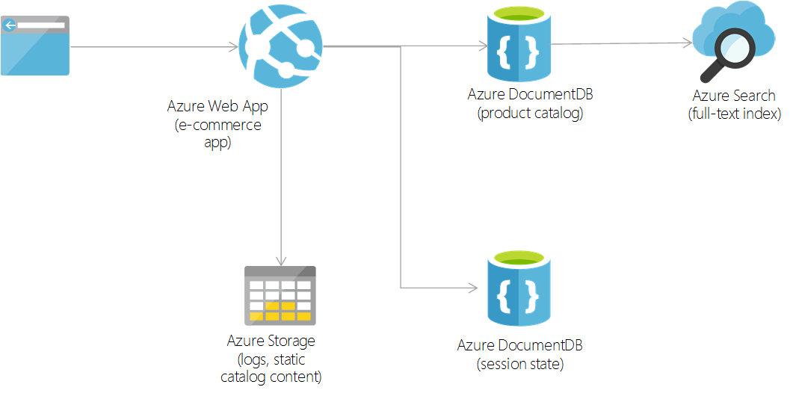
DocumentDb
Stores data in json
Schema-less
Stores complex, hierarchical data
Highly scalable

Slide 22
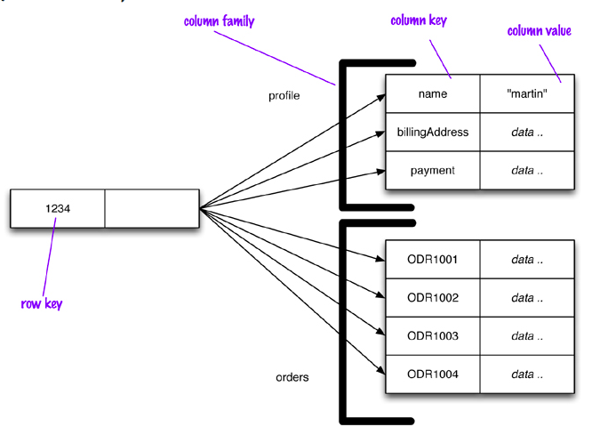
Column Family

Slide 23
Hbase
Part of the Hadoop eco system
Commonly augmented with Hive
Can handle very large amounts of writes in a short period of time

Slide 24
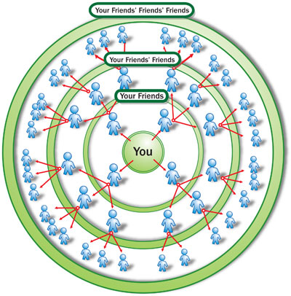
Graph

Slide 25
Gremlin
Nodes and relationships
Data with many complex relationships
Typically used to augment the system of record

Slide 26
Document
Key Value
Column Family
Graph

Slide 27
So How Do I Choose?

Slide 28
CAP Theorem
Never Gonna Get It
Consistency
CosmosDB
Hbase
SQL
CosmosDB
Partition Tolerance
Availability
CosmosDB
Azure Redis Cache

Slide 29
Issues To Consider
What are the relationships
How much data, and how fast is it coming in
How the data will be accessed
Data access performance requirements
Consistency/Transactional requirements
Entity complexity
Programmer skill level

Slide 30
NoSQL Guidelines
Key Value
Column Family
Document
Graph
Lots of data
Simple data structure
Quickly perform small read and write operations
Inexpensive, fairly simple
Need to add data items willy nilly
Lots of data
Insanely huge amounts of data
Need high performance
No joins
Lots of data
Need high performance
More complex data structure
Need to add data items willy nilly
Lots of data
Lots of connections between entities
Quickly changing relationships between entities

Slide 31
Common Use Cases
Azure Redis Cache
Leaderboards, Shopping Carts
Latest x items of anything
Deletes and filters
Cache
Azure Table Storage
Large amounts of data with a flat structure
Fast querying using the partition and row keys
DocumentDb
Product catalogs, gaming, social networking
Hbase
Voting, Race, anything with huge amounts of data being generated in huge bursts, telemetry
Gremlin
Social networking relationships, anything with complex and changing relationships between entities

Slide 32
Why Choose Only One?
Problem
Solution
Lots of data
Fairly simple data structure
Lots of small reads and writes
Need high performance
Need high availability
Need fast searching on columns other than the key
Use Azure Storage
Augment with Redis Cache for searching

Slide 33
Why Choose Only One?
Problem
Solution
Really need high consistency
Highly structured data
Current data is not really large
Historical data is huge
And we need to report on historical data
Use Azure Sql
Archive to DocumentDb

Slide 34

Don’t Forget Good Ole SQL
Just cause it’s old, doesn’t mean it’s not cool anymore

Slide 35

Resources
Anne Bougie
anne.bougie@gmail.com
@bougiefever
http://www.bougiefever.com
https://github.com/Bougiefever
Slides on GitHub https://github.com/Bougiefever/AzureNoSqlDataPrimer
A Newbie Guide to Databases https://blog.appdynamics.com/engineering/a-newbie-guide-to-databases/
That NoSQL Thing: Column (Family) Databases https://ayende.com/blog/4500/that-no-sql-thing-column-family-databases
NoSQL Distilled: A Brief Guide to the Emerging World of Polyglot Persistence http://a.co/1YwtJ47
On Sharding Graph Databases http://jimwebber.org/2011/02/on-sharding-graph-databases/
Azure Cosmos DB Documentation https://docs.microsoft.com/en-us/azure/cosmos-db/

